Slide 1

MGMT 68700
Predicting Superhost Status: A Data-Driven Approach
This presentation explores a data-driven method to predict Airbnb Superhost status in Chicago.
By
Krithiga Rajan Sangeetha Rajan
Nandini Devalla
Shashank Sridhar

Slide 2





Airbnb Business Model and Stakeholders
Airbnb operates as a platform-based business model, connecting various stakeholders within its ecosystem. Understanding the relationships between these stakeholders is crucial for developing effective strategies.
Hosts
Guests
Property owners who list their spaces on Airbnb
Travelers looking for unique accommodations
Platform
Investors
Airbnb, facilitating connections and transactions
Individuals or entities investing in Airbnb properties

Slide 3


Superhost Certification Program
The Superhost certification program is a key feature of Airbnb's platform, designed to recognize and reward high-quality hosts. This program offers benefits across the entire spectrum of stakeholders.
Enhanced Reputation
Improved Guest Satisfaction
Highlights reliable hosts, boosting platform credibility
Attracts guests seeking quality stays, raising overall satisfaction
Increased Bookings
Recognition & Support
Attracts more guests due to trust, potentially increasing earnings
Access to better customer service, resources, and promotions
Criteria for Becoming a Superhost
Hosted at least 10 trips
Maintained a 90% response rate when responding to guests' requests
Completed all confirmed reservations without cancellation
Received a 5-star review at least 80% of the time

Slide 4
Business Problem and Definition
Business Problem
Problem Definition
The goal is to predict which hosts are likely to become superhosts and which current superhosts are at risk of losing their status. This insight will allow targeted intervention, enabling proactive strategies to support hosts or address issues.
1. Target Variable:
host_is_superhost_in_period:
1: The host is a superhost during the period.
0: The host is not a superhost during the period.
2. Features:
Use historical and behavioral data (e.g., reviews, response rates, cancellations, booking patterns) to predict future outcomes.
Business Context
Risk
Superhost status is crucial for building trust and attracting more bookings.
Misclassifying superhosts can result in missed opportunities for customer support or inaccurate recommendations.

Slide 5

Superhost Prediction Model: Goals and Deliverables
Goals
Primary Goal: Predict which hosts will achieve or retain superhost status.
Secondary Goal: Predict which current superhosts are at risk of losing their status.
Deliverables
A trained predictive model that:
Flags hosts likely to become superhosts.
Identifies superhosts at risk of losing status.
Key insights into factors influencing superhost predictions:
Behavioral trends (e.g., reviews, cancellations).
Operational metrics (e.g., response time, booking patterns).
Recommendations for business strategies:
Support at-risk superhosts to maintain their status.
Guide hosts on improving their performance metrics to achieve superhost status.

Slide 6
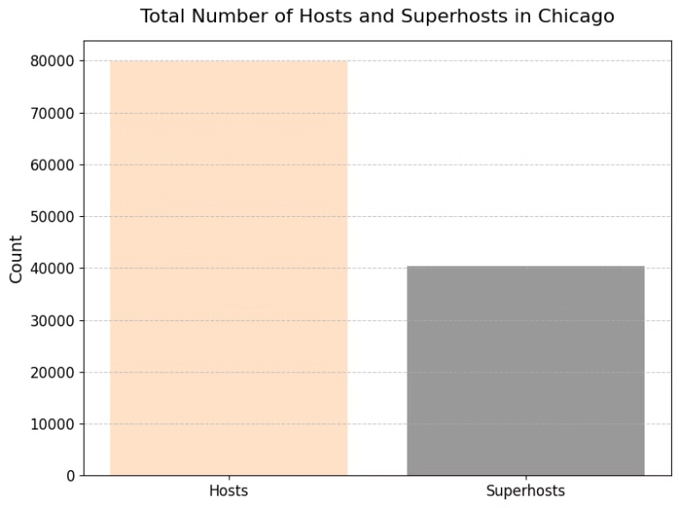
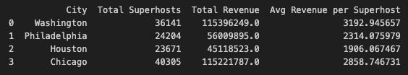
City Selection & Dataset Overview
Chicago: The Ideal Choice
Dataset Snapshot
Chicago boasts the highest number of superhosts among analyzed cities, providing robust data for model training and insight derivation.
120,217 rows/ total hosts
111 features
79,912 Regular hosts
40,305 super hosts

Slide 7
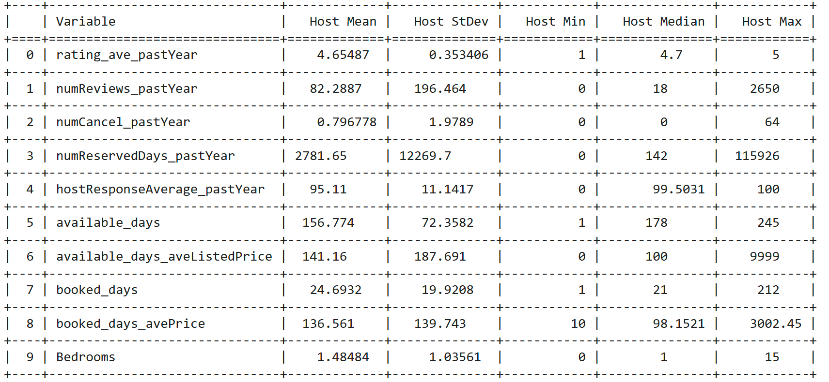
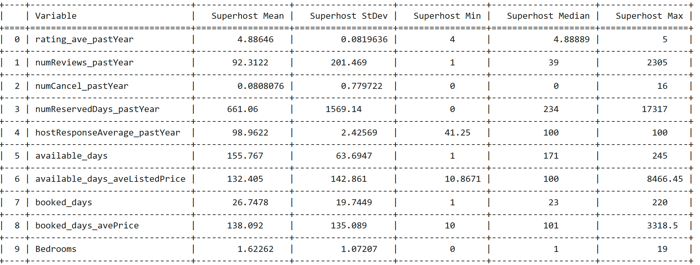
Descriptive Analysis: Superhosts vs. Regular Hosts
$130
80%
Superhost Nightly Rate
Superhost Occupancy Rate
Compared to $90 for regular hosts
Compared to 65% for regular hosts
$18K
180
Superhost Average Revenue
Superhost Booking Days
Compared to $12K for regular hosts
Compared to 120 days for regular hosts

Slide 8
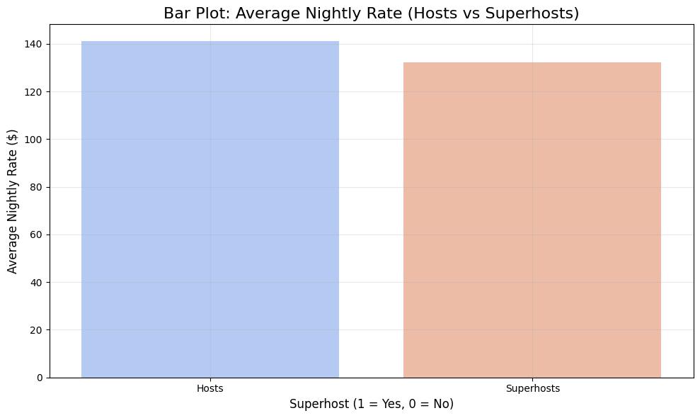
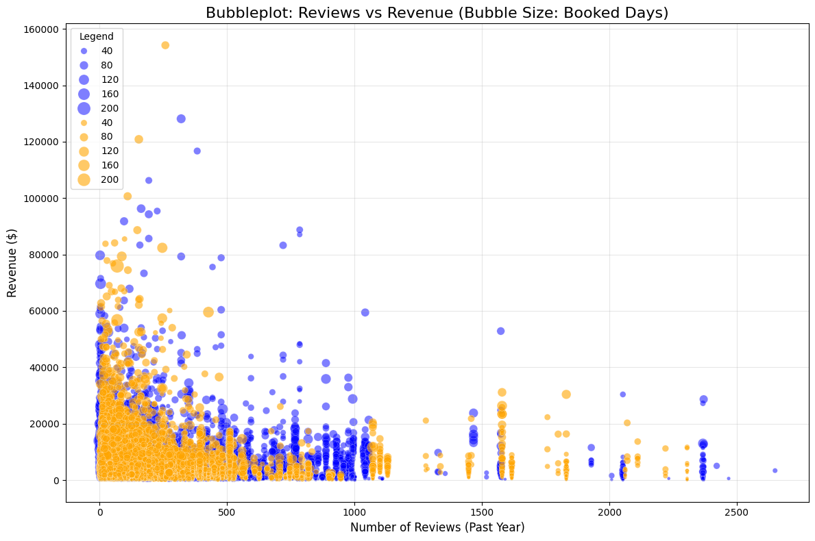
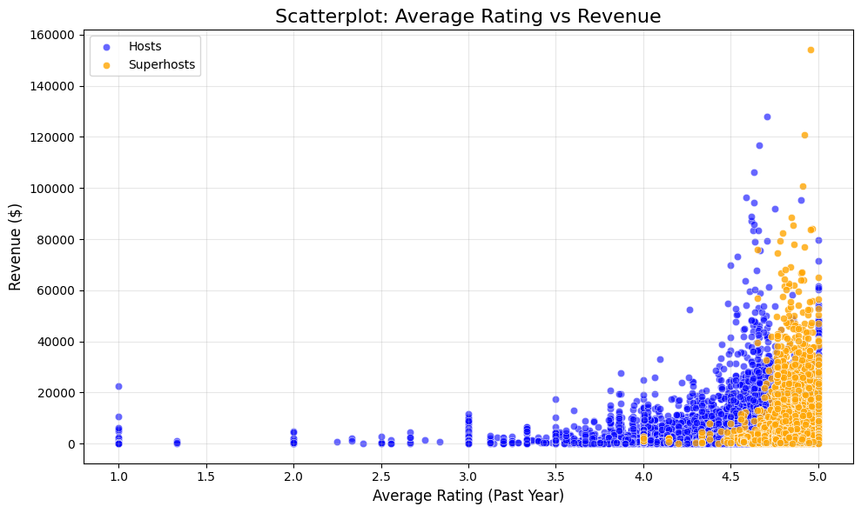
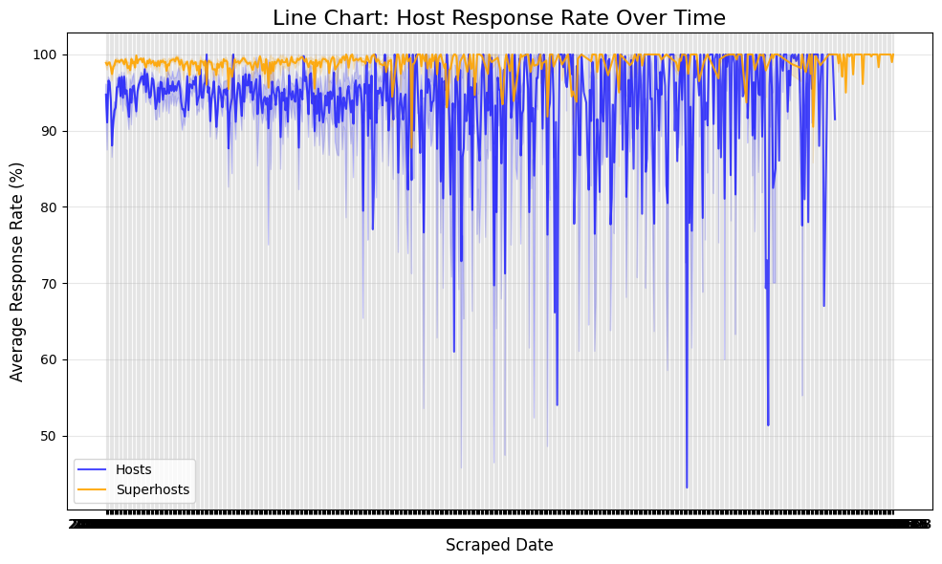
Descriptive Analysis: Superhosts vs. Regular Hosts

Slide 9
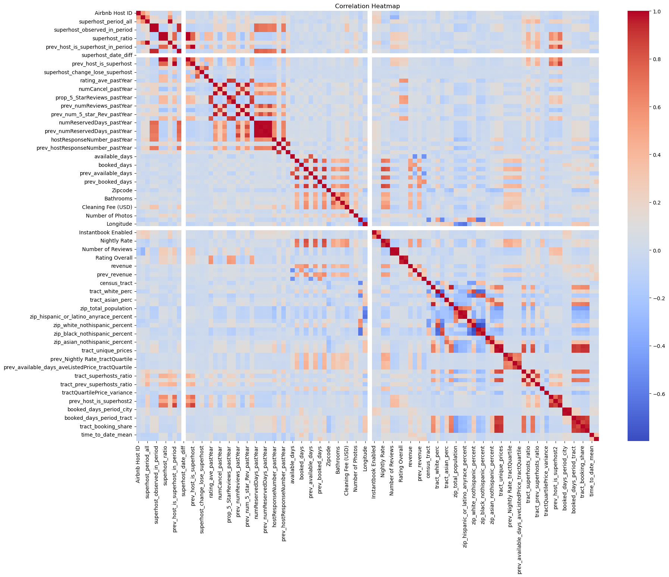



Data Preprocessing: Correlation Analysis
Initial Dataset
Started with 111 features in the original dataset.
Correlation Analysis
Identified and removed highly correlated features to avoid redundancy.
Final Dataset
Reduced to 83 columns after removing
correlated features.

Slide 10

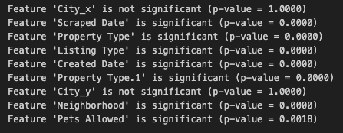

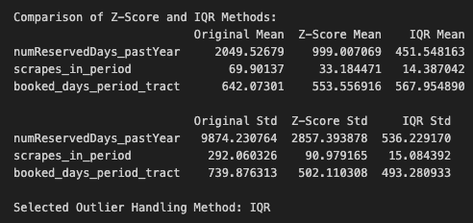

Data Preprocessing: Feature Selection and Cleaning
Chi-Square Test
Retained significant categorical features with p-value < 0.05.
Missing Values
Addressed 718,724 missing values.
Rating_ave_pastYear: 19,845 values imputed.
Time_to_date_mean: 38,108 values imputed.
Outlier Handling
Significant reduction in both mean and standard deviation,
effectively mitigating the influence of extreme outliers.

Slide 11
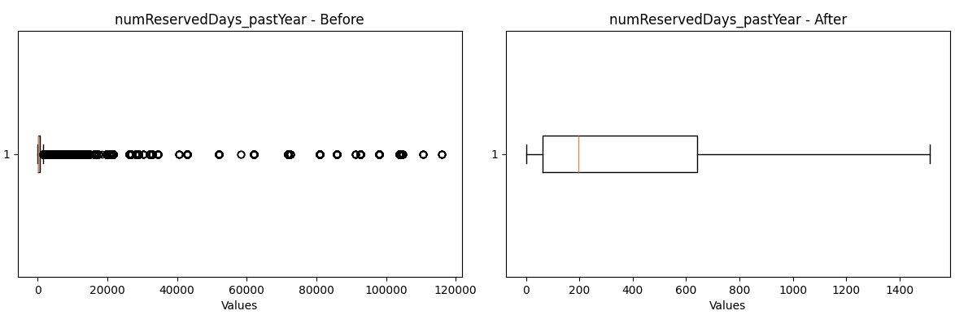
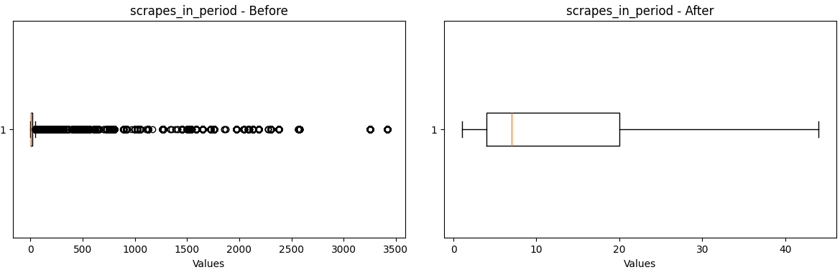
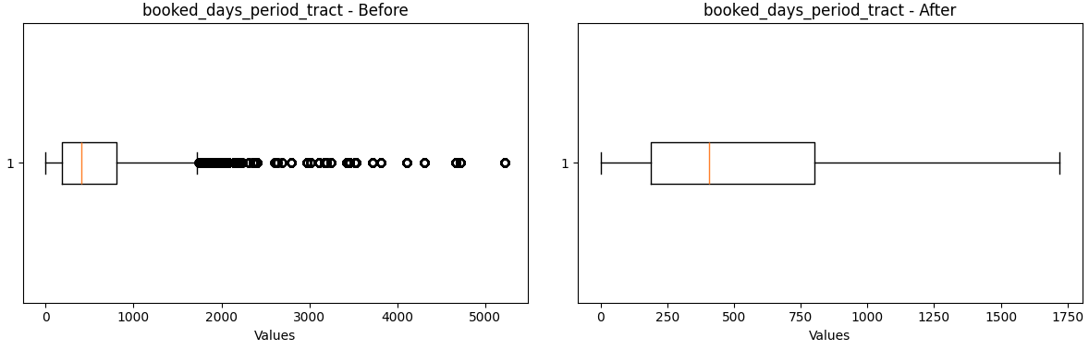
Data Preprocessing: Outlier Handling

Slide 12

Multicollinearity Reduction
1
VIF Analysis
Applied Variance Inflation Factor to identify multicollinearity among features.
2
Feature Dropping
Removed highly correlated features to reduce multicollinearity in the dataset.
3
Results
Dropped 2 highly correlated features (prop_5_StarReviews_pastYear, numReserv_pastYear), improving model stability and interpretability.

Slide 13
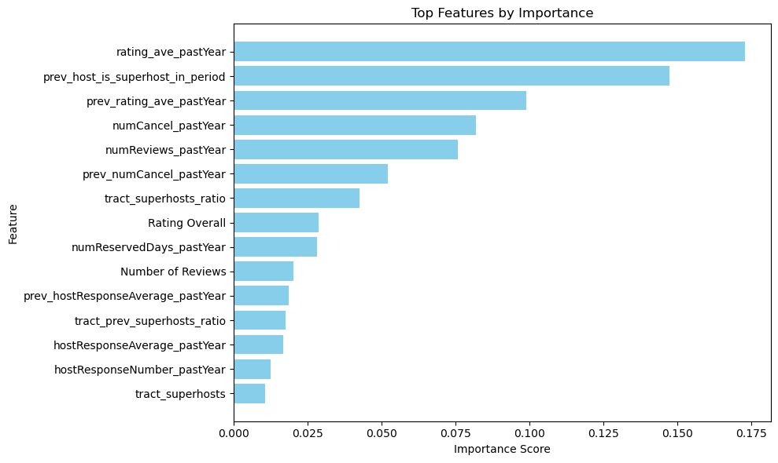
Feature Importance Analysis
Used Random Forest to rank feature importance.
Feature Reduction: Retained 15 important features based on the Random Forest importance threshold (> 0.01).
Key Features Retained such as rating_ave_pastYear, prev_host_is_superhost_in_period, tract_superhosts_ratio, Rating Overall, etc.

Slide 14
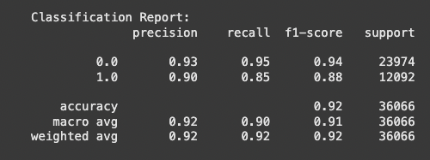
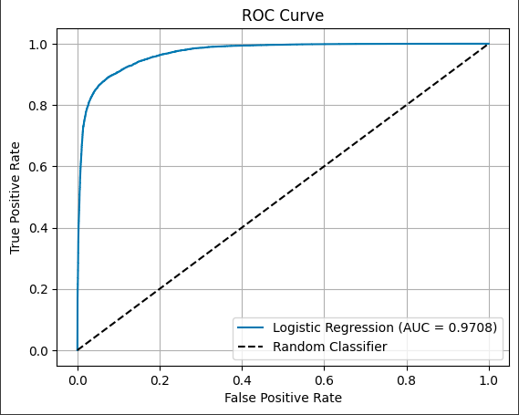
Model Building - Data Preparation and Baseline Model
Data Split
Training Set: 70% (84,151 rows)
Validation Set: 30% (36,066 rows)
Baseline Model: Logistic Regression
Accuracy: 92%
ROC-AUC: 97.08%
True Positives: 10,308
True Negatives: 22,873

Slide 15
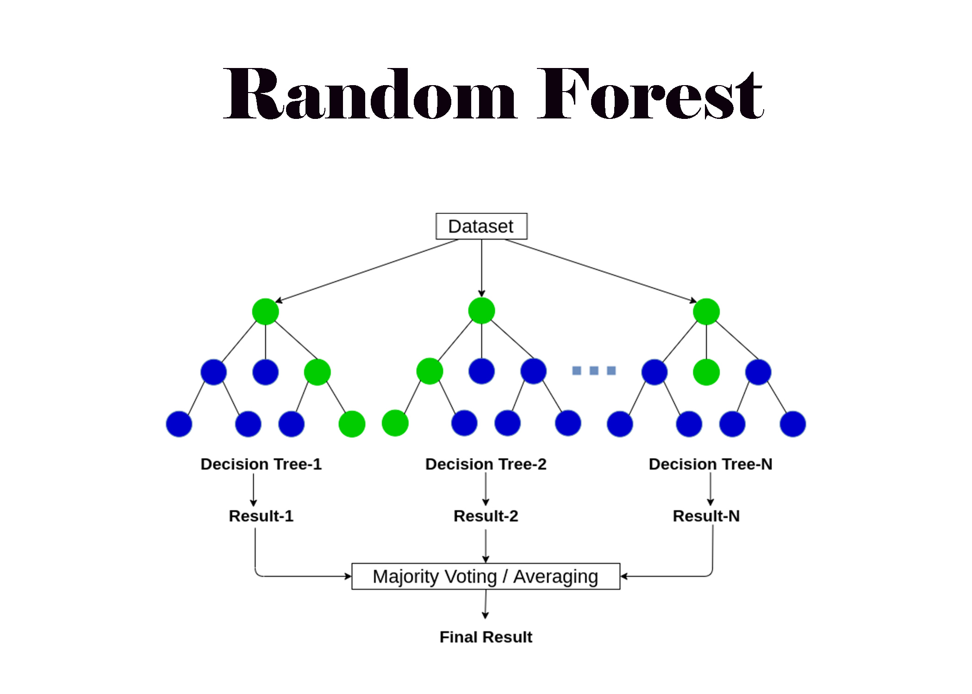
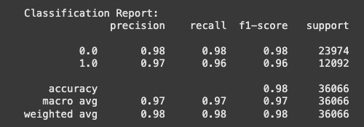
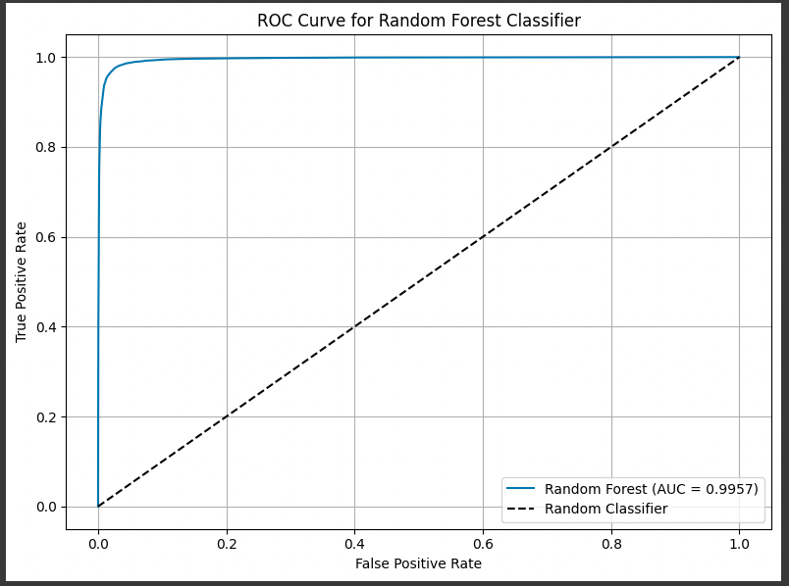
Model Building – Random Forest Classifier
Model: Random Forest Classifier
Accuracy: 97.59%
ROC-AUC: 99.57%
True Positives: 11,632
True Negatives: 23,566

Slide 16
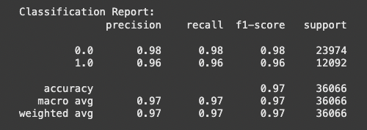
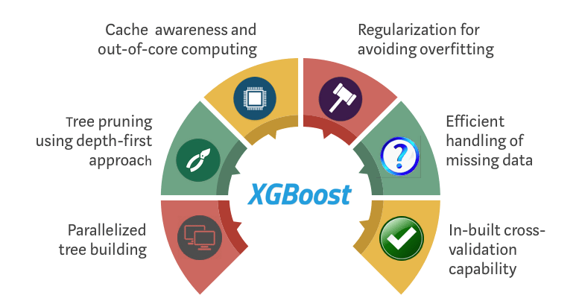
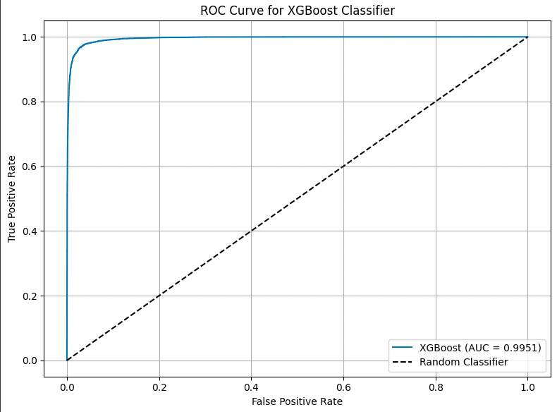
Model Building – XGBoost Classifier
Model: XGBoost Classifier
Accuracy: 97.01%
ROC-AUC: 99.51%
True Positives: 11,557
True Negatives: 23,432

Slide 17
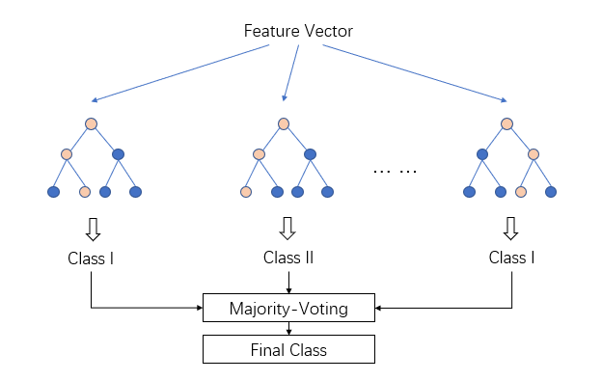
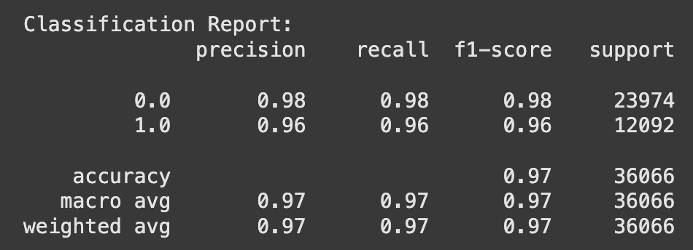
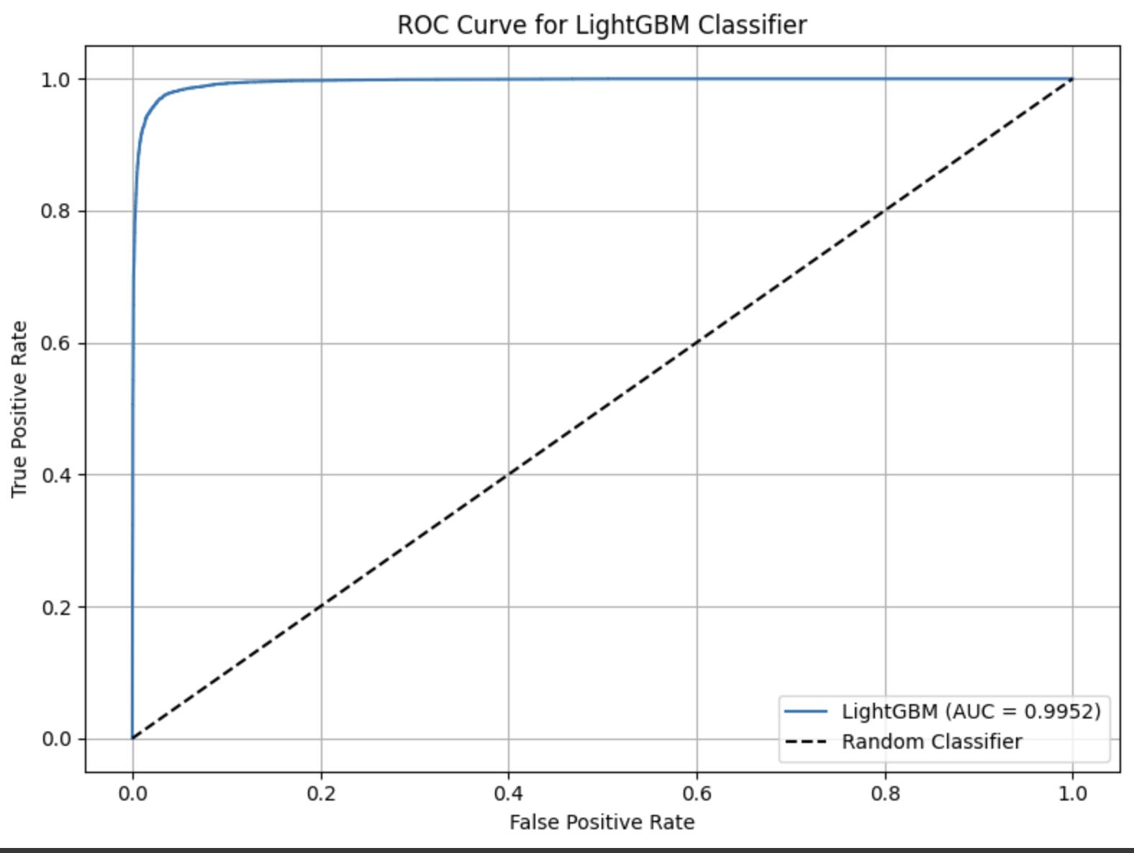
Model Building –LightBGM Classifier
Model: LightBGM Classifier
Accuracy: 97.1%
ROC-AUC: 99.52%
True Positives: 11,565
True Negatives: 23,455

Slide 18

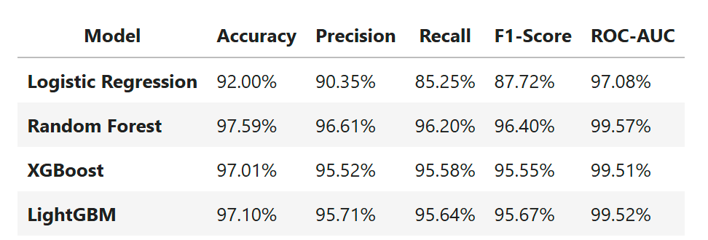
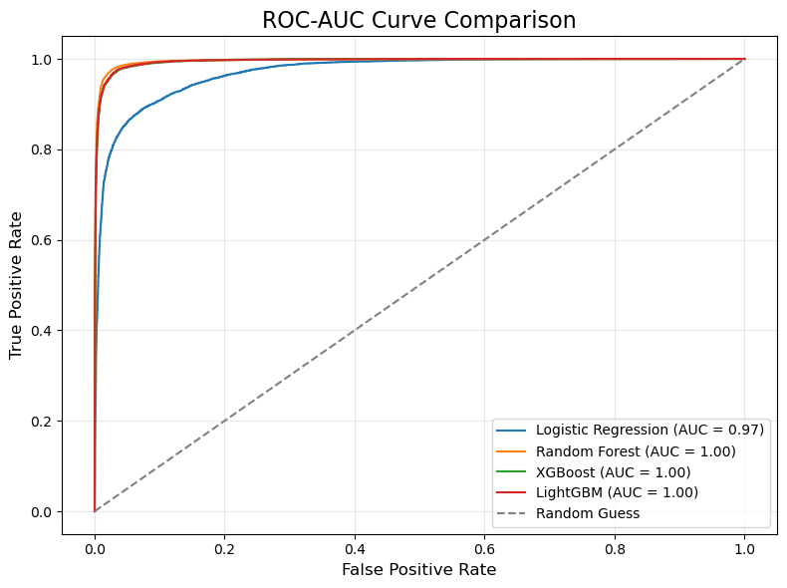
Model Comparison
Best Overall Model: Random Forest
Accuracy: Highest at 97.59%.
Precision, Recall, and F1-Score: All models perform similarly, but Random Forest stands out with slightly better precision and recall.
ROC-AUC: Random Forest leads with the best AUC, indicating the best classification separation between the two classes.
Model: Random Forest Classifier
Accuracy: 97.59%
ROC-AUC: 99.57%
True Positives: 11,632
True Negatives: 23,566

Slide 19
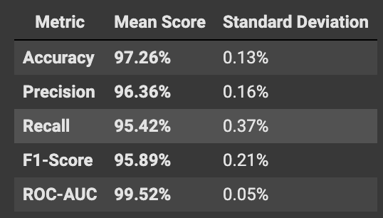
Random Forest Model: High Performance with
Cross-Validation
Model Selection
Key Results
A Random Forest model was chosen for its robust performance and ability to handle complex datasets. Its ensemble nature prevents overfitting.
97.26%
Performance Enhancement
Stratified k-fold cross-validation (k=10) was used to ensure reliable performance and avoid overfitting.
Accuracy
99.52%
ROC-AUC
The model showed high accuracy (97.26%), ROC-AUC (99.52%), precision (96.36%), and recall (95.42%). These results highlight its effectiveness.

Slide 20



Identifying and Nurturing Potential Airbnb Superhosts
75%
4.8
70%
High Review Hosts
High Rating Hosts
High Occupancy Hosts
Top 10% of hosts with highest review counts have a 75% chance of becoming Superhosts within 6 months.
Hosts with average ratings of 4.8 or higher have a 90% likelihood of achieving Superhost status.
Hosts with over 70% occupancy rate are 2.5x more likely to become Superhosts than those with lower rates.
Our predictive model reveals clear pathways to Superhost status. Hosts excelling in reviews, ratings, and occupancy rates show the highest potential. For instance, hosts with over 100 reviews per year demonstrate a remarkable 96% probability of achieving Superhost status.
To capitalize on these insights, Airbnb should focus on engaging the top 10% of hosts. By providing them with extra support, resources, and targeted promotion, we can significantly increase our Superhost community. This strategy not only rewards high-performing hosts but also elevates the overall quality of Airbnb experiences.

Slide 21



Identifying Superhosts at Risk of Losing Their Status
Declining Reviews
Low Occupancy
Declining Response Times
Hosts experiencing a 20% decline in reviews over the past year have a 65% chance of losing Superhost status.
Hosts experiencing a 15% drop in bookings are 3 times more likely to lose their Superhost status.
Superhosts with response times increasing by over 10% are twice as likely to lose their status.
If a host's review count dropped from 150 to 120, the chance of losing status increases to 70%.
If a host went from 200 booked days to 170, they have a 60% chance of losing their status.
If a host's response time went from 10 hours to 20 hours, their chance of losing status increases by 50%.

Slide 22



Actionable Recommendations
Potential Superhosts
At-Risk Superhosts
Proactive Monitoring System
Identify top 10% of hosts with high reviews and ratings.
Detect superhosts with declining reviews, decreasing occupancy, or increasing response time.
Set up a monitoring system that tracks both potential superhosts and those at risk in real-time, providing relevant interventions based on predictive insights.
Offer special perks, promotions, and training.
Offer timely intervention with tips, discounted services, or re-engagement strategies.
Prioritize outreach programs.

Slide 23



Business Strategy for Airbnb
Targeted Superhost Campaigns
Support for At-Risk Superhosts
Data-Driven Insights
Identify high-potential hosts using machine learning. Offer exclusive resources and guidance to help them become Superhosts faster.
Proactively identify Superhosts at risk. Provide personalized support to help them maintain their Superhost status.
Use data analytics to understand host behavior and inform strategies for supporting Superhosts.

Slide 24
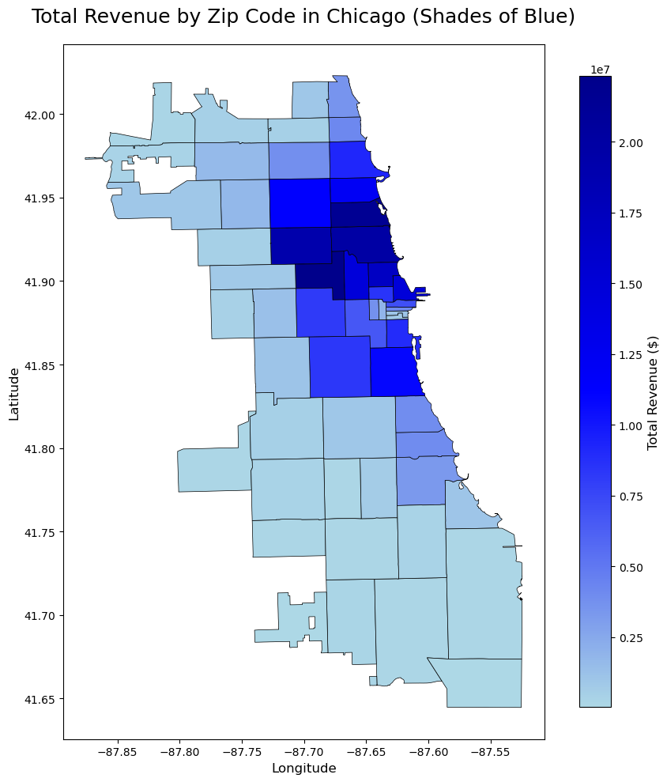
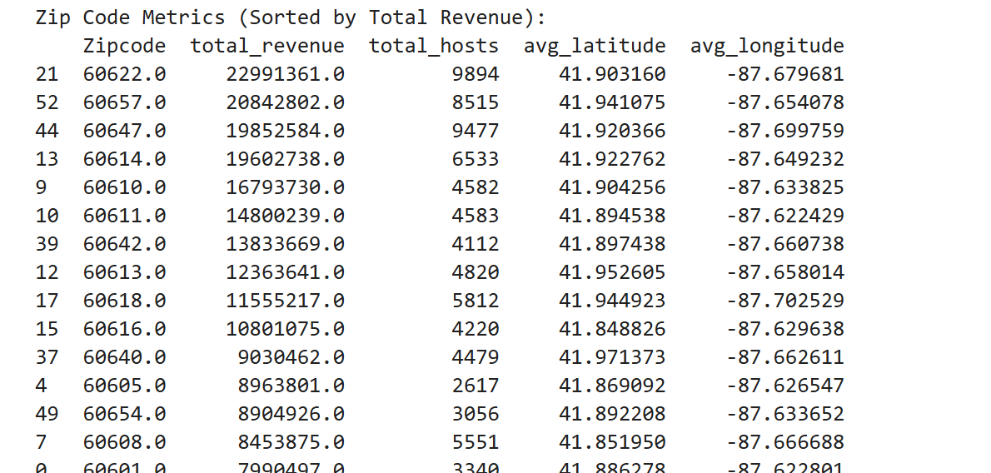
Neighborhood Performance in ZIP Code 60622
Four distinct neighborhoods comprise ZIP code 60622. Wicker Park, West Town/Noble Square, and Humboldt Park are the top-performing neighborhoods, generating the majority of revenue.
Bucktown, on the other hand, contributes significantly less to total revenue, with a lower number of hosts and superhosts compared to the other three neighborhoods.
Wicker Park and West Town/Noble Square lead in both revenue and the number of superhosts.
Humboldt Park has a considerable number of superhosts but generates less revenue compared to Wicker Park and West Town/Noble Square.
Bucktown trails significantly in revenue, suggesting potential for future growth.
Revenue Analysis
High-Performing Area
ZIP code 60622 is Chicago's top performer for Airbnb revenue. Strategic investment and marketing should focus here. This area offers excellent potential for new listings.
Untapped Potential
Geographic insights reveal untapped potential for Airbnb expansion. Incentivize underperforming areas to unlock additional revenue.
The average latitude and longitude help identify hotspot regions in Chicago, which can be visualized on a map to better understand Airbnb performance geographically.

Slide 25
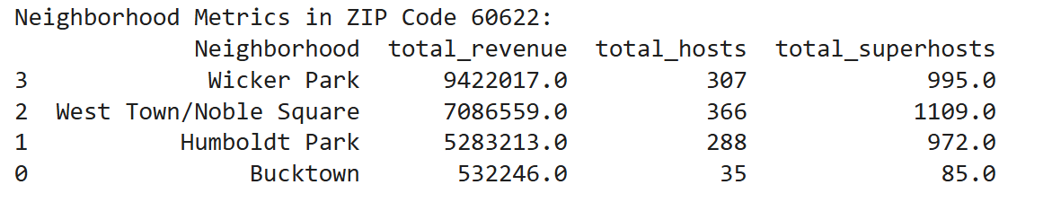
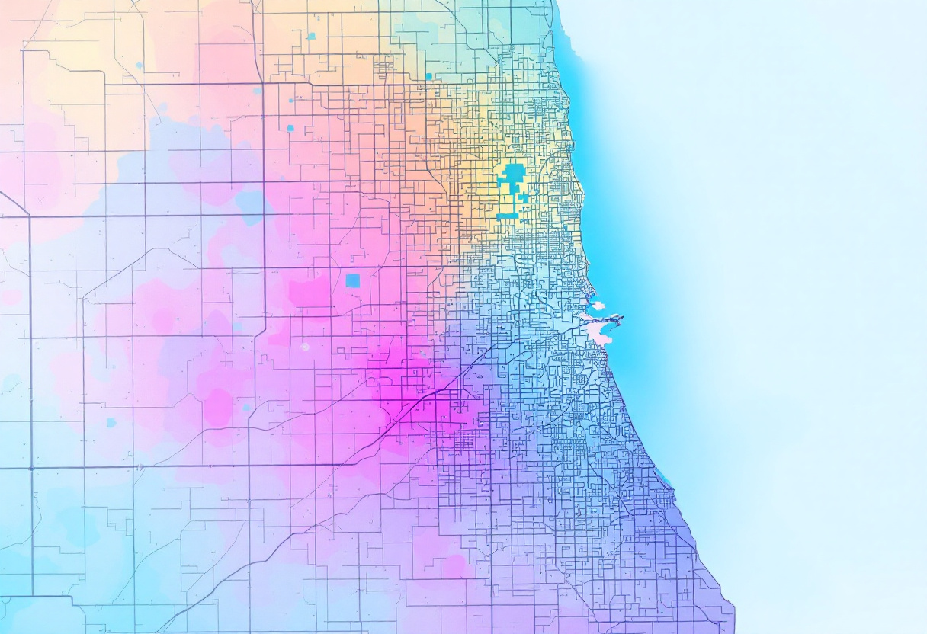
Neighborhood Analysis in Zip Code 60622
Four distinct neighborhoods comprise ZIP code 60622.
Wicker Park, West Town/Noble Square, and Humboldt Park are the top-performing neighborhoods, generating the majority of revenue.
Bucktown, on the other hand, contributes significantly less to total revenue, with a lower number of hosts and superhosts compared to the other three neighborhoods.
Wicker Park and West Town/Noble Square lead in both revenue and the number of superhosts.
Humboldt Park has a considerable number of superhosts but generates less revenue compared to Wicker Park and West Town/Noble Square.
Bucktown trails significantly in revenue, suggesting potential for future growth.

Slide 26
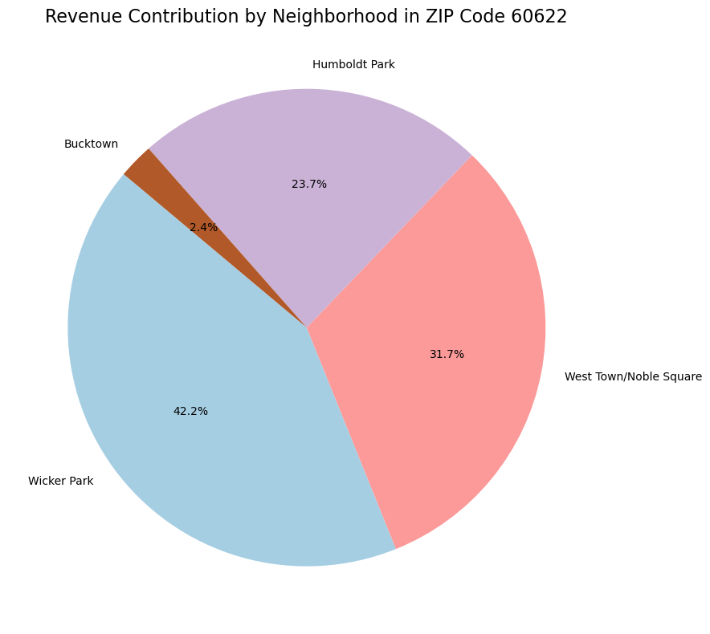
Revenue Breakdown by Neighborhood
Wicker Park contributes the largest share of revenue (42.2%), confirming its dominance in ZIP code 60622.
West Town/Noble Square contributes the second-largest share (31.7%).
Humboldt Park contributes a moderate share (23.7%).
Bucktown contributes the least (2.4%), indicating its minimal impact on total revenue.
Revenue is highly concentrated in Wicker Park and West Town/Noble Square, which together account for almost 74% of the total revenue in ZIP code 60622.
Bucktown's contribution is negligible, highlighting it as an area with potential for growth.

Slide 27
Property Breakdown and Comparison
Property Type | Wicker Park | West Town/Noble Square
Total Properties | 3,112 | 4,917
Entire Home/Apt | 1,308 | 3,130
Private Room | 27 | 56
Shared Room | 0 | 1
Other | 1,730 | 1,730
Insights
Wicker Park has a higher average nightly rate (166.46) than WestTown/NobleSquare (153.71), which may contribute to its higher total revenue.
Both neighborhoods have similar occupancy rates (around 0.19), indicating comparable demand levels for Airbnb listings.
Listings in Wicker Park are booked slightly more often (26.10 days on average) compared to West Town/Noble Square (25.25 days).
Wicker Park generates significantly higher average revenue per property (4,145.20)thanWestTown/NobleSquare(3,044.06).This is likely influenced by Wicker Park's higher nightly rates and slightly better booking performance.
West Town/Noble Square has significantly more total properties (4,917) compared to Wicker Park (3,112).

Slide 28

Thank You
We appreciate your time and interest! We are available for any follow-up questions or additional insights.

